Slide 1
Controlling Traveling-Wave Phonons at Room Temperature
Joel N. Johnson
April 25th, 2025
Northern Arizona University

Slide 2
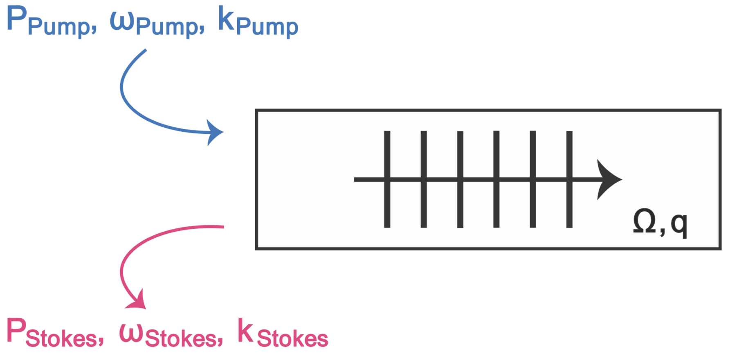
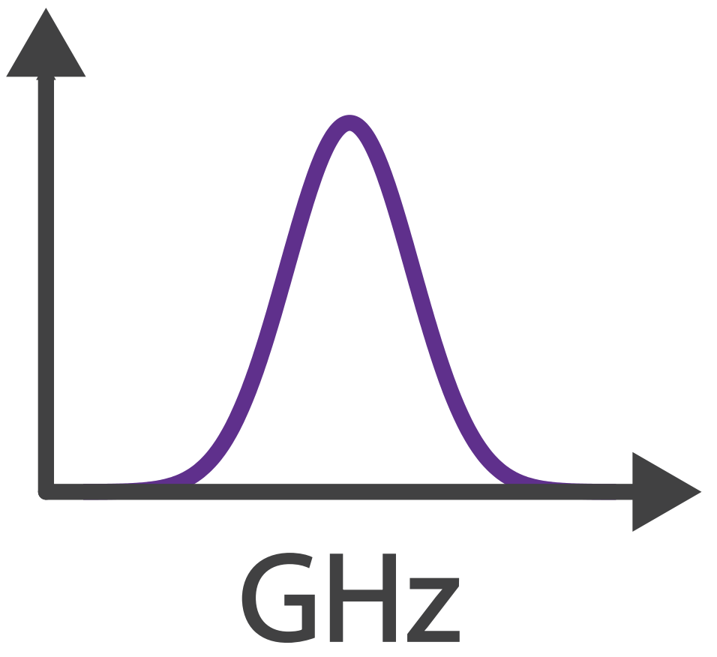
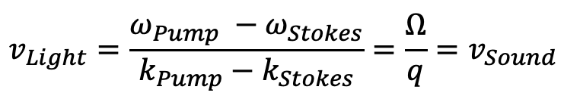

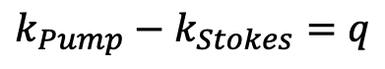
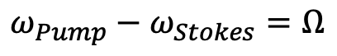
Brillouin Scattering, Optomechanical Coupling
Phase (velocity) matching:
$$v_{Light}=\frac{ω_{Pump} −ω_{Stokes}}{k_{Pump}−k_{Stokes}}=\frac{Ω}{q}=v_{Sound}$$
✓
Energy Conservation:
$$ω_{Pump}−ω_{Stokes}=Ω$$
✓
Momentum Conservation:
$$k_{Pump}−k_{Stokes}=q$$
$$Ω$$

Slide 3
Controlling Sound with Light
Laser Cooling of Traveling-Wave Phonons in an Optical Fiber
Quieting sound with light
Coherently stimulated Brillouin Scattering (CoBS)
Amplifying sound to measure subtle signals
Brillouin-Induced Raman Modes
Harnessing sound for engineered behaviors

Slide 4
Laser Cooling
Why do we care about laser cooling?
Reduce thermal noise
Access quantum regimes
Demonstrated for discrete cavity systems
Resonant cavities permit discrete modes
Tune laser just red of cavity resonance → discrete mode cooling

Slide 5
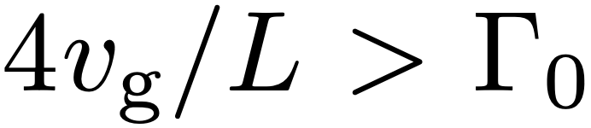
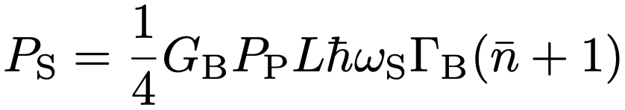
Laser Cooling of a Continuum of Modes
Fast escape condition
Remove phonons faster than they are replenished:
Challenging because scattered power scales with length:

Slide 6
Laser Cooling of a Continuum of Modes
Fast escape condition
Remove phonons faster than they are replenished:
Challenging because scattered power scales with length:
Gain
Power
Thermal

Slide 7
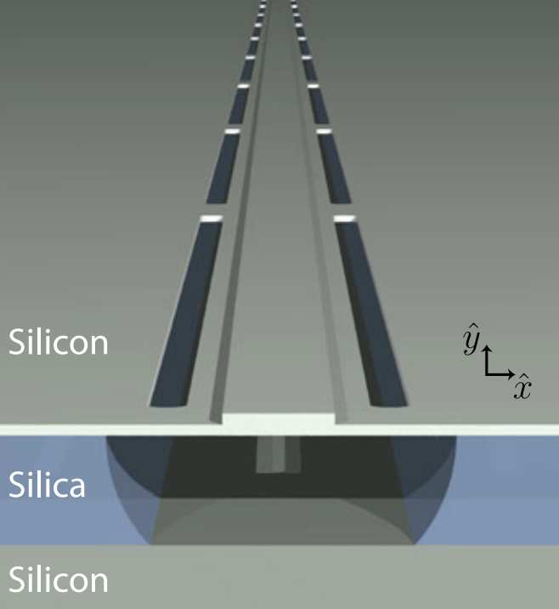
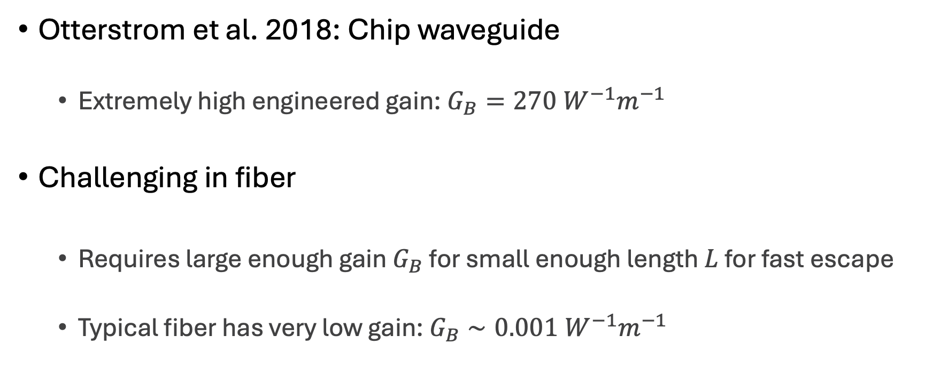
Laser Cooling of a Continuum of Modes
Otterstrom et al. 2018: Chip waveguide
Extremely high engineered gain: $G_{B}=270 W^{−1}m^{−1}$
Challenging in fiber
Requires large enough gain $G_{B}$ for small enough length $L$ for fast escape
Typical fiber has very low gain: $G_{B}∼0.001 W^{−1}m^{−1}$

Slide 8
Optomechanical Cooling
Material at room temperature has thermal fluctuations (phonons)
Ω
phonon

Slide 9
Optomechanical Cooling
Material at room temperature has thermal fluctuations (phonons)
Laser light
Ω
⍵
phonon

Slide 10
Optomechanical Cooling
Material at room temperature has thermal fluctuations (phonons)
Laser light backscatters off approaching sound wave (Brillouin scattering)
Ω
⍵
phonon

Slide 11
Optomechanical Cooling
Material at room temperature has thermal fluctuations (phonons)
Laser light backscatters off approaching sound wave (Brillouin scattering)
Energy transfers from sound to light:
Returning light is frequency upshifted (blue-shifted)
⍵’ = ⍵ + Ω
Ω
⍵
phonon

Slide 12
Optomechanical Cooling
Material at room temperature has thermal fluctuations (phonons)
Laser light backscatters off approaching sound wave (Brillouin scattering)
Energy transfers from sound to light:
Returning light is frequency upshifted (blue-shifted)
Sound wave intensity is lowered (cooled)
⍵’ = ⍵ + Ω
Ω
⍵
phonon

Slide 13
Optomechanical Cooling
Material at room temperature has thermal fluctuations (phonons)
Laser light backscatters off approaching sound wave (Brillouin scattering)
Energy transfers from sound to light:
Returning light is frequency upshifted (blue-shifted)
Sound wave intensity is lowered (cooled)
⍵’ = ⍵ + Ω
Ω
⍵
phonon

Slide 14
Optomechanical Cooling
Material at room temperature has thermal fluctuations (phonons)
Laser light backscatters off approaching sound wave (Brillouin scattering)
Energy transfers from sound to light:
Returning light is frequency upshifted (blue-shifted)
Sound wave intensity is lowered (cooled)
Anti-Stokes
⍵’ = ⍵ + Ω
Ω
⍵
phonon

Slide 15
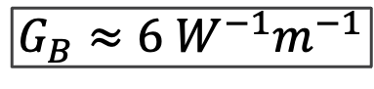
Solution: CS₂-Filled Liquid-Core Optical Fiber
Carbon disulfide (CS₂) is a very high gain liquid
Fill hollow-core optical fiber with CS₂:
1 meter
SMF-28
UHNA7
hollow-core
UHNA7
SMF-28
~1.68 µm
$$G_{B}≈6 W^{−1}m^{−1}$$

Slide 16
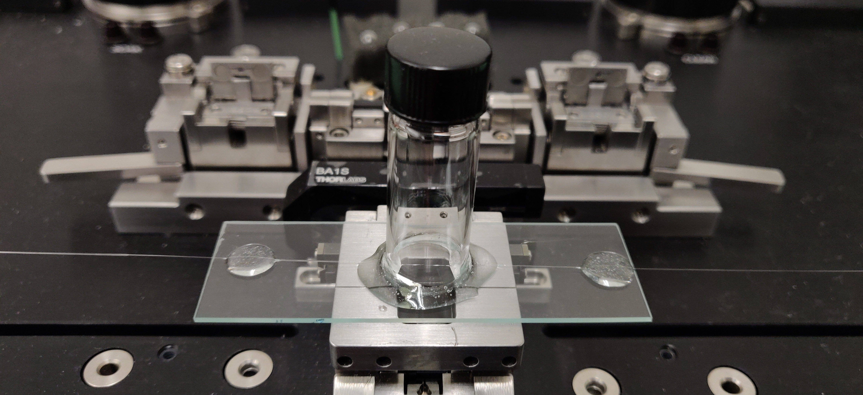
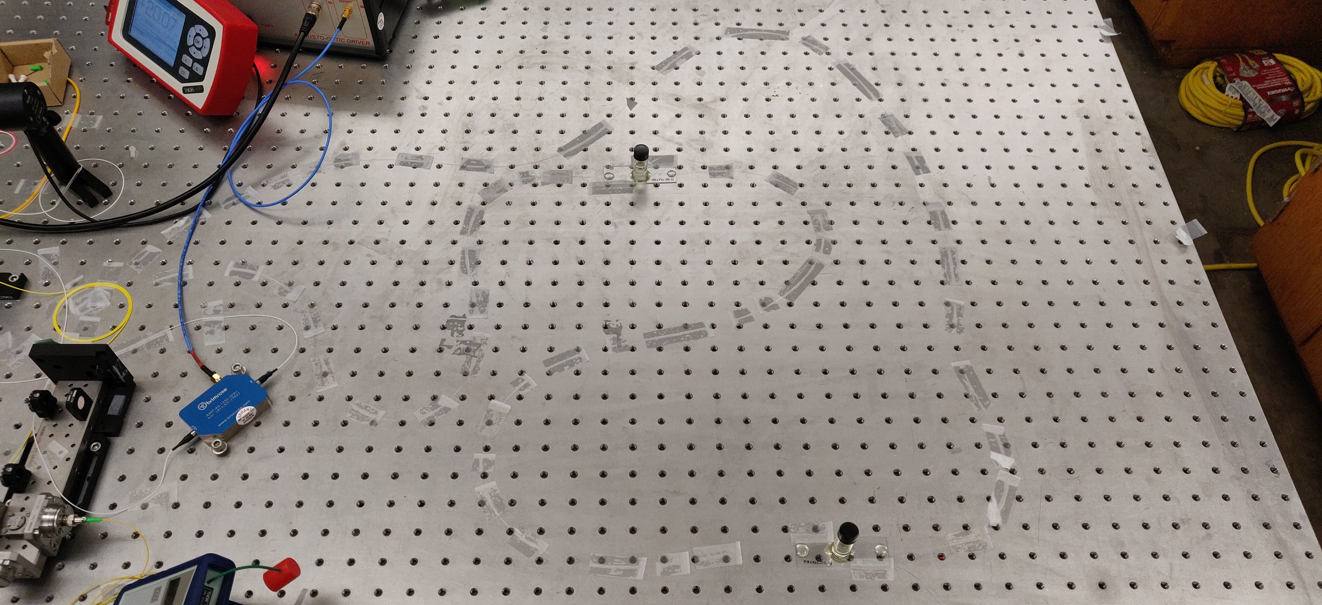
Liquid-core Optical Fiber Sample

Slide 17
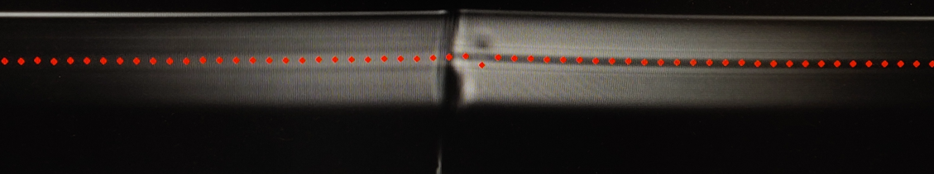
Liquid-core Optical Fiber Sample

Slide 18
Liquid-core Optical Fiber Sample
CS₂ enters here

Slide 19

Liquid-core Optical Fiber Sample
CS₂ enters here

Slide 20
Cooling Figure of Merit
All materials have a natural rate of mechanical dissipation (Γ₀)
To cool is to increase dissipation rate (Γ₊)
Spectral linewidth gives dissipation rate
Broadened linewidth gives measure of cooling
Γ

Slide 21
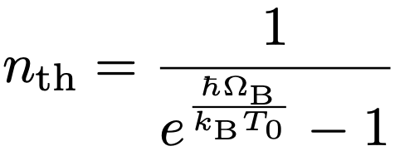
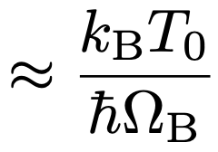
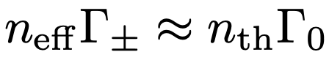
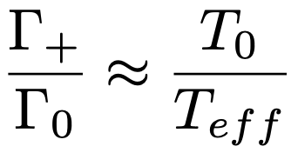
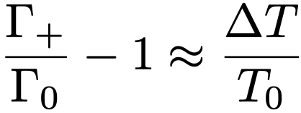
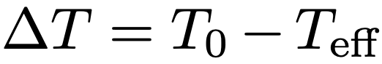
Cooling Figure of Merit
Broadened linewidth gives measure of cooling:

Slide 22
Experimental Setup

Slide 23
Results
Γ

Slide 24
Results
Γ

Slide 25
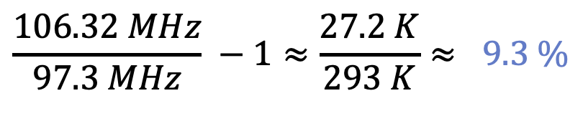
Results
$$\frac{106.32 MHz}{97.3 MHz} −1≈\frac{27.2 K}{293 K}≈ 9.3 \%$$
Cooling from room temperature

Slide 26
CoBS

Slide 27
Raman

Slide 28
Conclusion
People, organizations, institutions to thank

Slide 29
Optomechanical Heating
Material at room temperature has thermal fluctuations (phonons)
Ω
phonon

Slide 30
Optomechanical Heating
Material at room temperature has thermal fluctuations (phonons)
Laser light
Ω
⍵
phonon

Slide 31
Optomechanical Heating
Material at room temperature has thermal fluctuations (phonons)
Laser light backscatters off retreating sound wave (Brillouin scattering)
Ω
⍵
phonon

Slide 32
Optomechanical Heating
Material at room temperature has thermal fluctuations (phonons)
Laser light backscatters off retreating sound wave (Brillouin scattering)
Energy transfers from light to sound:
Returning light is frequency downshifted (red-shifted)
⍵’ = ⍵ - Ω
Ω
⍵
phonon

Slide 33
Optomechanical Heating
Material at room temperature has thermal fluctuations (phonons)
Laser light backscatters off retreating sound wave (Brillouin scattering)
Energy transfers from light to sound:
Returning light is frequency downshifted (red-shifted)
Sound wave intensity is increased (heated)
⍵’ = ⍵ - Ω
Ω
⍵
phonon

Slide 34
Optomechanical Heating
Material at room temperature has thermal fluctuations (phonons)
Laser light backscatters off retreating sound wave (Brillouin scattering)
Energy transfers from light to sound:
Returning light is frequency downshifted (red-shifted)
Sound wave intensity is increased (heated)
⍵’ = ⍵ - Ω
Ω
⍵
phonon

Slide 35
Optomechanical Heating
Material at room temperature has thermal fluctuations (phonons)
Laser light backscatters off retreating sound wave (Brillouin scattering)
Energy transfers from light to sound:
Returning light is frequency downshifted (red-shifted)
Sound wave intensity is increased (heated)
Stokes
⍵’ = ⍵ - Ω
Ω
⍵
phonon

